Slide 1
Math 152 – Lesson 6
Lesson | Topic | Reading | Homework
T5 | The Fundamental Theorem of Calculus | 5.3 | 2,9,21,23,25,37,43,45,53
T6 | Indefinite Integrals & Net Change Theorem | 5.4 | 19,21,49,51,63
T7 | Substitution Rule | 5.5 | 3,5,17,33,53,80
Upcoming Suspenses
Today | FSQ 1
11 Sep | FSQ 2/FSPA 2
15 Sep | GR1/HW Set 2/Webwork 1

Slide 2



HW Problems

Slide 3
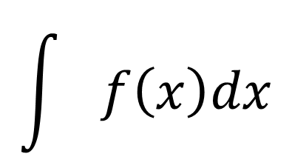
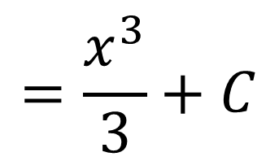
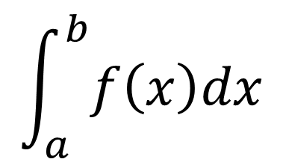
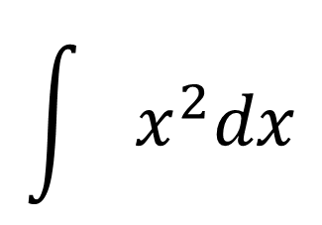


Definite v. Indefinite Integrals
$$\int_{a}^{b}{f\left(x\right)dx}$$
$$\int{f\left(x\right)dx}$$
$$\int{x^{2}dx}$$
$$\int_{1}^{3}{x^{2}dx}=\frac{3^{3}}{3}−\frac{1^{3}}{3}$$
$$=\frac{x^{3}}{3}+C$$
$$=\frac{26}{3}$$

Slide 4

Net Change Theorem
This principle can be applied to all rates of change in nature and sciences

Slide 5

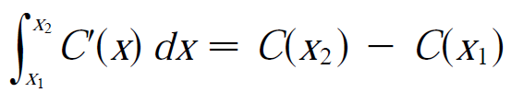
Net Change Theorem - Examples
If V(t) is the volume of water in a reservoir at time t, then its derivative is V’(t) the rate at which water flows into the reservoir at time t. So
If C(x) is the cost of producing x units of a commodity, then the marginal cost is the derivative C’(x). So

Slide 6
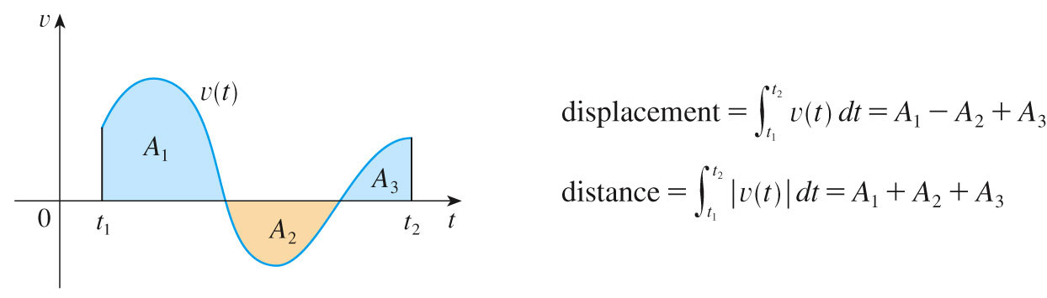
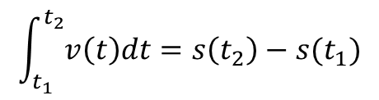
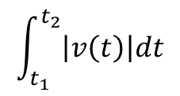
Net Change Theorem - Examples
Displacement = net change in position:
Total distance traveled:
$$\int_{t_{1}}^{t_{2}}{v\left(t\right)dt=s\left(t_{2}\right)−s(t_{1})}$$
$$\int_{t_{1}}^{t_{2}}{\left|v\left(t\right)\right|dt}$$

Slide 7
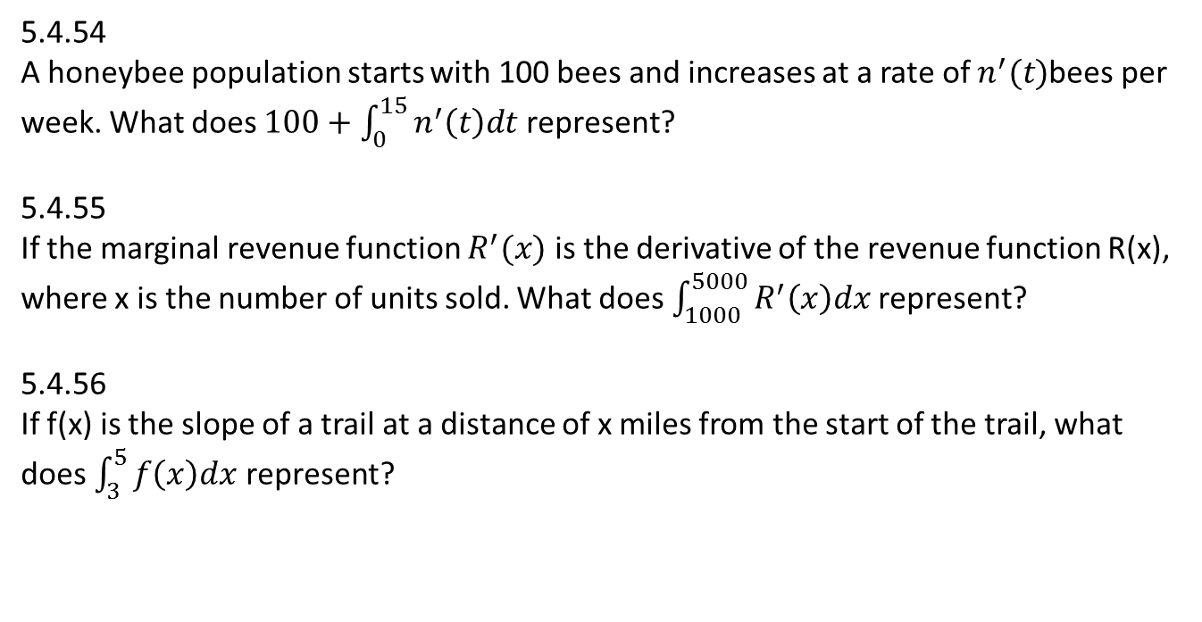
Net Change Theorem - Examples
5.4.54
A honeybee population starts with 100 bees and increases at a rate of $n^{′}(t)$bees per week. What does $100+\int_{0}^{15}{n^{′}\left(t\right)dt}$ represent?
5.4.55
If the marginal revenue function $R^{′}(x)$ is the derivative of the revenue function R(x), where x is the number of units sold. What does $\int_{1000}^{5000}{R^{′}\left(x\right)dx }$represent?
5.4.56
If f(x) is the slope of a trail at a distance of x miles from the start of the trail, what does $\int_{3}^{5}{f\left(x\right)dx}$ represent?

